Slide 1

Choice of Task
Task 1 – Music Quiz Game
Task 2 – Dice Game
Task 3 – Card Game
Date started | Date completed
12/03/2020

Slide 2
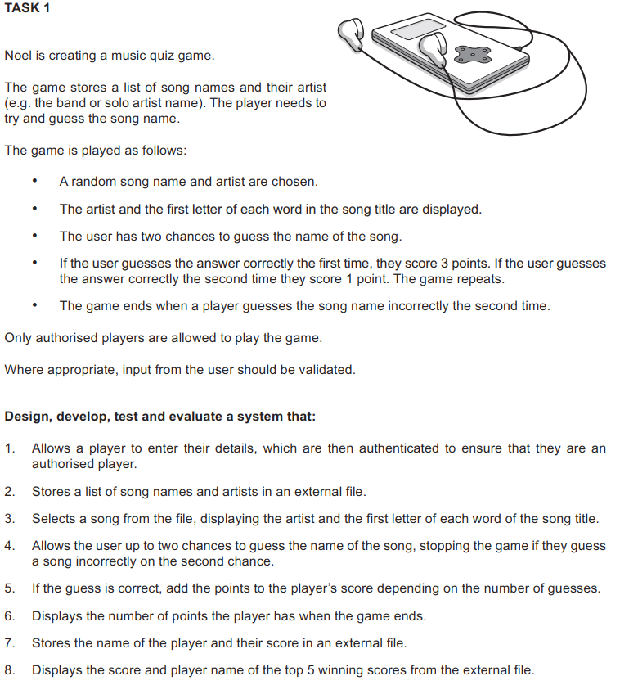
Task 1 – Music Quiz Game

Slide 3
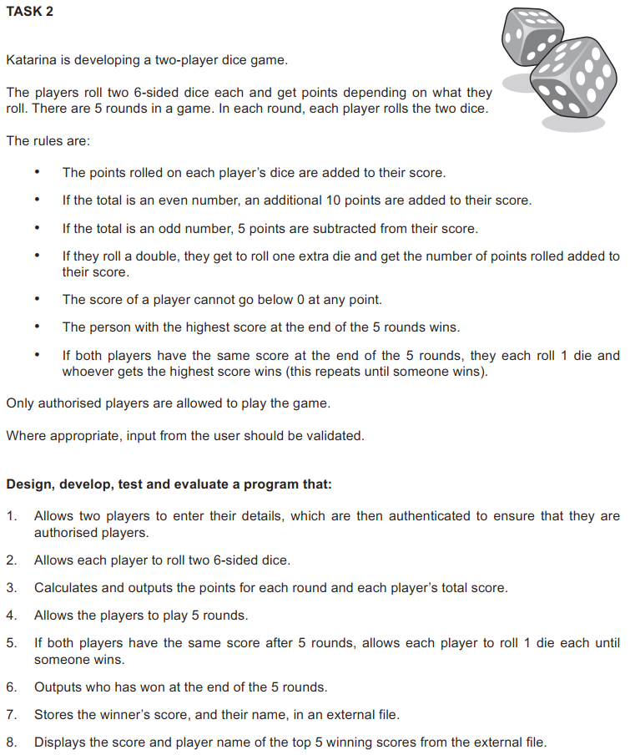
Task 2 – Dice Game

Slide 4
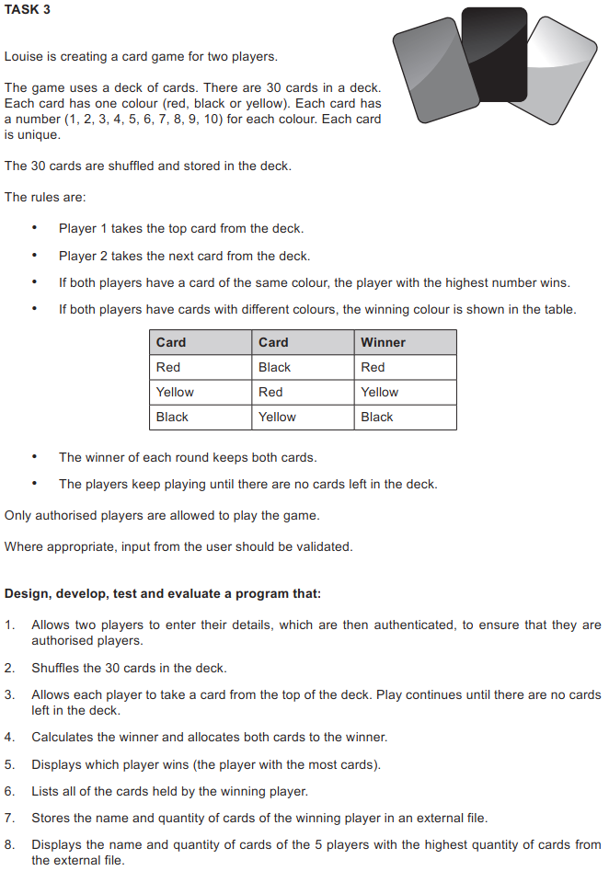
Task 3 – Card Game

Slide 5
Analysis

Slide 6
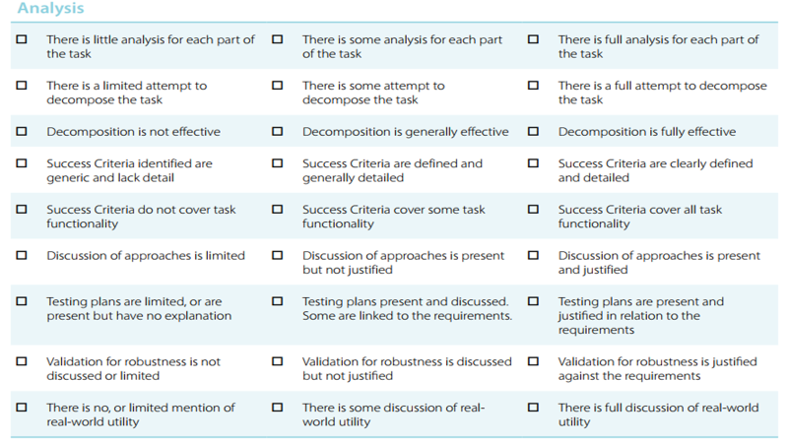

Slide 7
Success Criteria:
User can login (by password)- authenticated
/create username can be create
/random generated number (1-6)
Generate two times
Play five round
Another player five round
Each round break show summon
Show congratulate to winner and show point
/create external file
/external score winner name
/ask if same config next time?
/sort top 5
https://discuss.codecademy.com/t/how-can-i-check-if-a-number-is-odd/339354
https://stackoverflow.com/que510348/how-can-i-make-a-time-delay-in-pythonstions/

Slide 8
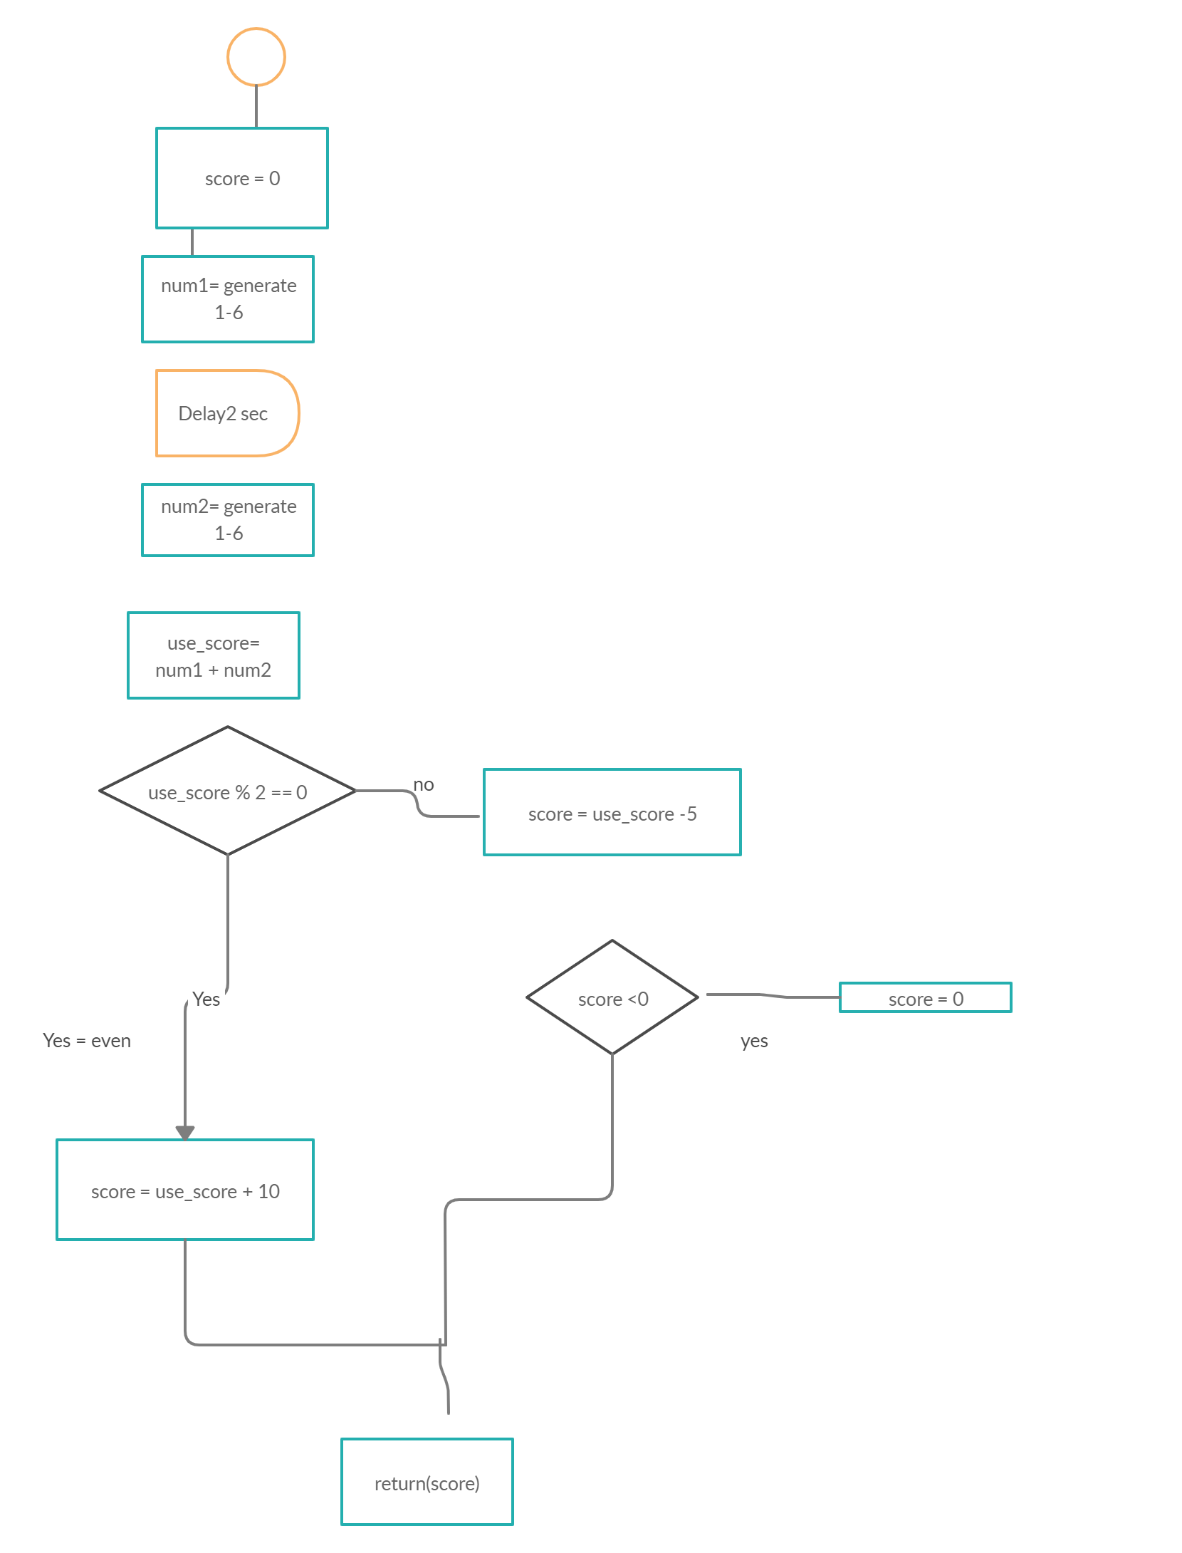
Program roll()
Flow chart
no
Output you have num1 and num2 and you got score

Slide 9
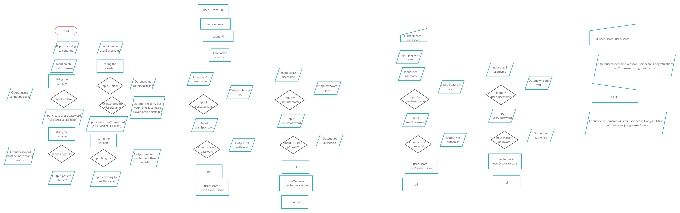

Slide 10
Export and read top 5

Slide 11

Design

Slide 12
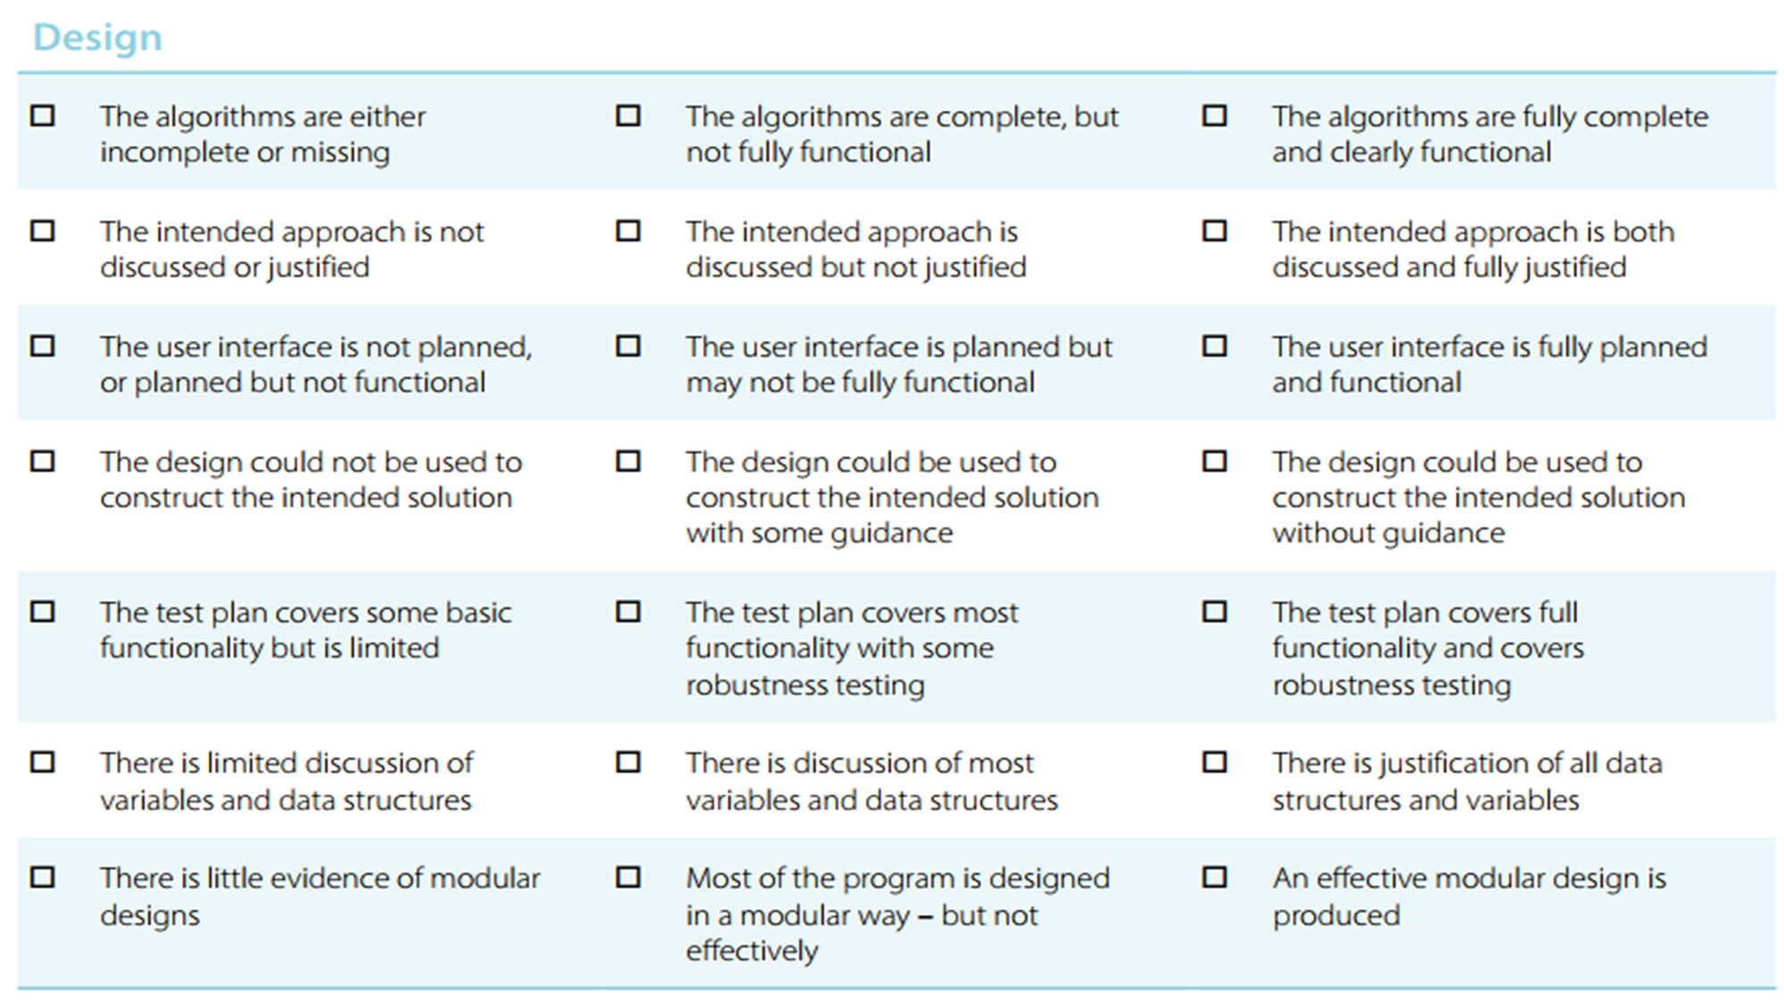

Slide 13
code

Slide 15
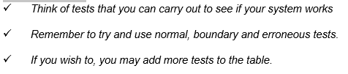
Test design
Test | What am I testing? | What data will I use? | Normal/Boundary/Erroneous? | Expected Result
1 | File created?
2 | Can input name
3 | Can input passsword
4

Slide 16

Development

Slide 17
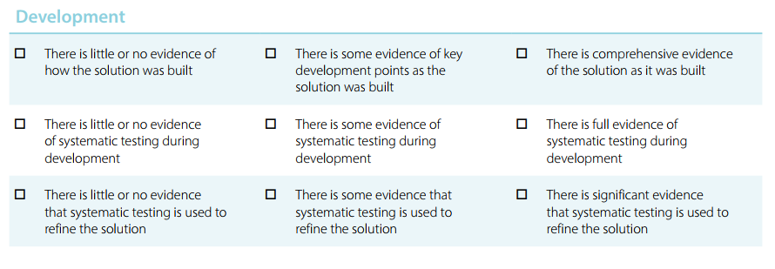

Slide 18
Python code

Slide 20
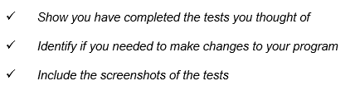
Testing

Slide 21
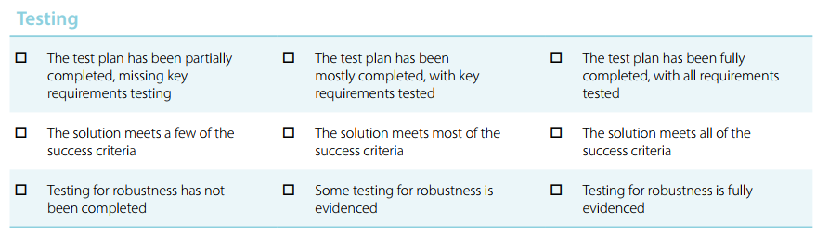

Slide 22
My tests:
Test | What am I testing? | Expected result | Pass/Fail | Do I need to change my program? If so, how?
1
2
3
4
5

Slide 23
Test Evidence
Video recording

Slide 25
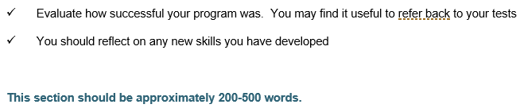
Evaluation

Slide 26
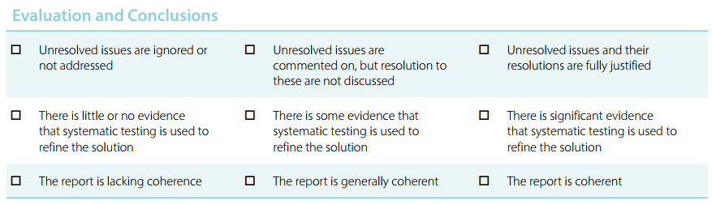

Slide 27
How successful was my program?

Slide 28
What new skills have I developed?

